Slide 1
Patient Safety Authority
Leader in Patient Safety or
Apologist for the Status Quo

Slide 2
Outline of Presentation
Mcare Law of 2002
  Formation of the Patient Safety Authority (PSA)
  Development of PA Patient Safety Reporting System
PA Act 52 – Healthcare Associated Infection (HAI) Law of 2008
PSA Strategic Plan 2007
  Education
  Collaboration
Current Activities

Slide 3
PA Mcare Law 2002
Primary Goal: Reduce and eliminate medical errors by identifying problems and implementing solutions that promote patient safety in the Commonwealth.
Required medical facilities to:
  Develop and implement a Patient Safety Plan
  Designate a Patient Safety Officer
  Establish a Patient Safety Committee
Prohibits retaliation (“whistle blower” protection)

Slide 4
PA Mcare Law 2002
Created Patient Safety Authority
Established Patient Safety Trust Fund
Required mandatory reporting of serious events, incidents, and infrastructure failures in medical facilities making Pennsylvania the first and only state to require reporting of both actual adverse events and near misses (incidents)
Required mandatory disclosure of serious events to patients
Provided penalties for failure to report

Slide 5
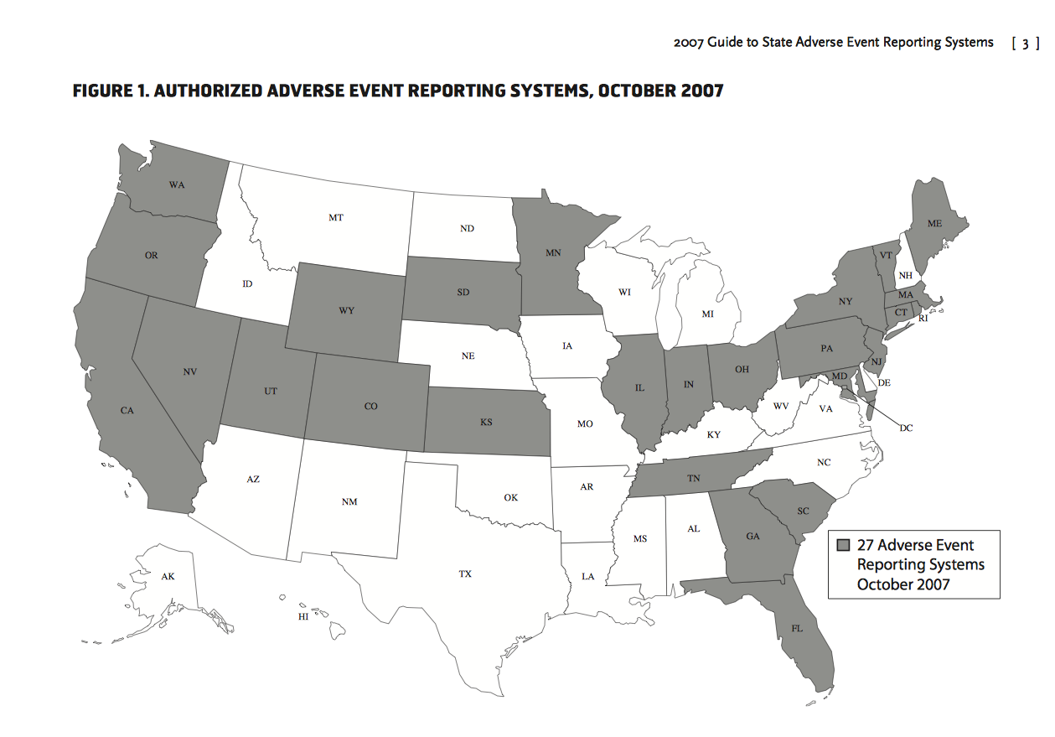

Slide 6
Formulation and System
Development: 2002-2004
Contracted with:
    ECRI Institute
    Institute for Safe Medication Practices
    Hewlett Packard for IT support
Developed Pennsylvania Patient Safety Reporting System (PA-PSRS)
Modeled after Aviation Safety Reporting System

Slide 7
Successful Adverse Event Reporting
In the article Reporting of Adverse Events, Lucian Leape (2002) identifies seven characteristics of successful reporting systems:
          Non-punitive
          Confidential
          Independent
          Expert analysis
          Timely
          Systems-oriented
          Responsive
This categorizes the PA-PSRS

Slide 8
Patient Safety Authority
11-member Board appointed by the Governor and Legislature
Independent Agency
Non-regulatory
Dedicated Funding Stream
Strategically focused on education, collaboration, and guidance

Slide 9
PSA and PA Department of Health
The PSA differs from the Department of Health in is role with respect to reporting of Serious Events and Incidents.
Reports of Serious Events and Incidents are submitted to the Pennsylvania Patient Safety Authority for the purposes of learning how the healthcare system can be made safer in Pennsylvania.
In contrast, reports of Serious Events and Infrastructure Failure are submitted to the Department of Health for the purposes of fulfilling their role as a regulator of Pennsylvania healthcare facilities.

Slide 10
Definition of Patient Safety*
Patient safety:
“Freedom from accidental injury,” or “avoiding injuries or harm to patients from care that is intended to help them.”
*Envisioning the National Health Care Quality Report.
Washington, DC: Institute of Medicine; 2001.

Slide 11
Incident
Incident - “An event, occurrence or situation involving the clinical care of a patient in a medical facility which could have injured the patient but did not either cause an unanticipated injury or require the delivery of additional health care services to the patient”
  Must be reported by any staff/provider who reasonably believes one has occurred as soon as practicable in accordance with Facility’s Patient Safety Plan

Slide 12
Serious Event
Serious Event - “An event, occurrence or situation involving the clinical care of a patient in a medical facility that results in death or compromises patient safety, and results in an unanticipated injury requiring the delivery of additional health care services to the patient”
  Must be reported by any staff/provider who reasonably believes one has occurred in accordance with Facility’s Patient Safety Plan; provider’s failure to do do results in notification of licensure board.

Slide 13
Patient Disclosure - Mcare
“ Duty to notify patient.
A medical facility through an appropriate designee shall provide written notification to a patient affected by a serious event or, with the consent of the patient, to an available family member or designee within seven days of the occurrence of discovery of a serious event.”

Slide 14
Unanticipated Outcome
Unanticipated Outcome:
A negative or unexpected result stemming from a diagnostic test, medical judgment or treatment, surgical intervention, or from the failure to perform a test, treatment, or intervention.
May not be the result of error or negligence

Slide 15
Adverse Event
Adverse event (complication):
“An injury caused by medical management rather than by the underlying disease or condition of the patient.” In general, adverse events prolong the hospitalization, produce a disability at the time of discharge, or both.

Slide 16
Medical Error – Two Definitions
Medical error: “The failure of a planned action to be completed as intended (i.e., error of execution) or the use of a wrong plan to achieve an aim (i.e., error of planning). It also includes failure of an unplanned action that should have been completed (omission)*
Medical error: A preventable adverse event
* Institute of Medicine, 2000

Slide 17
PA Act 52 - HAI Law
Direct reporting to CDC's National Healthcare Safety Network (NHSN) began 2/14/08
All Healthcare Associated Infections (HAIs) to be considered as “serious events” and must be reported to PSA and DOH
December 31, 2008— All hospitals implemented a qualified electronic surveillance system
Nursing homes began submitting HAIs in 2009

Slide 18
Infection Awareness and Reduction
  Worked closely with DOH and PHC4
  Contracted with HAI professionals
  Established, populated and used HAI Advisory Panel
  Hospitals
    Established hospital reporting requirements
    Webinars, Advisory articles, and research
    Collaboratives including vaccination

Slide 19
Infection Awareness and Reduction
Nursing Homes
  Developed reporting requirements and criteria for HAI
  Developed and implemented PA-PSRS for nursing homes
  Live training for 1,200
  Analytical reports
  Webinars, Advisory articles and research

Slide 20
HAI Reporting
All hospitals are required to report all HAIs associated with any in-patient location using the Patient Safety Module of CDC’s National Healthcare Safety Network (NHSN).
NHSN uses standardized definitions for each of these infection types, including methods for their detection, how they are to be identified, and the time frames for the infection to occur upon and after hospitalization.

Slide 21
HAIs Reported
Bone and joint infections (BJ)
Blood stream infections (BSI) with or without a central line,
BSI associated with a central line Central Line Associated Bloodstream Infections (CLABSI)
Central nervous system infections (CNS)
Cardiovascular system infections
(CVS)
Eye, Ear Nose and Throat infections (EENT)
Gastrointestinal infections (GI)
Lower respiratory tract infections (LRI)
Pneumonia (PNEU) whether ventilator or non-ventilator associated
Reproductive tract infections (REPR)
Skin and soft tissue infections (SST)
Surgical site infections (SSI)
Systemic infections (SYS)
Urinary tract infections (UTI)
UTI associated with a urinary catheter are known as Catheter Associated Urinary Tract Infections (CAUTI)

Slide 22
PA-PSRS
Nine primary event types and 217 secondary and tertiary event types.
Each event is assigned a harm score
Facilities are able to view their own data via analytical reports in PA-PSRS
Dual use by the Authority and DOH
Electronic triage algorithm
Electronic interface reduces input resource use

Slide 23
PA-PSRS Reporting System
All information submitted through PA-PSRS is confidential, and no information about individual facilities is made public.
PA-PSRS is a facility-based reporting system.
The Department of Health can issue sanctions and penalties, including fines and forfeiture of license, to healthcare facilities who fail to comply.
Between January 1 and December 31, 2012, Pennsylvania acute care facilities submitted 235,249 reports through the Pennsylvania Patient Safety Reporting System (PA-PSRS).
To date, over 2.0 million reports have been submitted through PA-PSRS. Approximately, 3.4 percent were Serious Events (events that caused harm), while 96.6 percent were Incidents or near-misses (events that did not cause harm). Nursing homes in Pennsylvania submitted a total of 32,257 infection reports through PA-PSRS in 2012; a 1.5 percent decrease from the 32,761 submitted in 2011.

Slide 24
PA-PSRS - Reporting Components
Who Reports
Types of Events
Other Considerations
Hospitals
Ambulatory Surgical Facilities
Birthing Centers
Certain Abortion
Facilities
Nursing Homes - HAI
  Near-Misses (“Incidents”)
  Adverse Events (“Serious Events”)
  Infrastructure Failures
  HAI Events
Mandatory
No Individual Identifying Data
Confidentiality Provisions
Non-discoverable
Whistleblower Protections
Written Patient Notification

Slide 25








Pennsylvania Event Reporting
FACILITIES
SYSTEMS
AGENCIES
HAI
(NHSN)
National Healthcare Safety Network
Patient Safety Events
Harm Events
Infrastructure Failure
NH HAI
ASFs/Birthing/Some Abortion Facilities
Patient Safety Events & HAI
Harm Events
HAI
Non-Harm Events
NH HAI

Slide 26
Reports Submitted to PA-PSRS (approx.) in 2012
Facility Type | Harm | No Harm | NH HAI | Total
Acute Hospital | 5,148 | 196,843 |  | 201,991
Other Hospital | 1,314 | 26,712 |  | 28,026
Ambulatory Surgery Centers | 1,559 | 3,408 |  | 4,967
Other | 18 | 247 |  | 265
Nursing Homes |  |  | 32,257 | 32,257
Total | 8,039 | 227,210 | 32,257 | 267,506
Reports submitted in 2012

Slide 27
Reports Submitted to PA-PSRS in 2012
Event Type | Serious Events | Incidents | Total | % of Total
Medication Errors | 235 | 42,663 | 42,898 | 18%
Adverse Drug Reactions (not a medication error) | 287 | 4,844 | 5,131 | 2%
Equipment / Supplies / Devices | 42 | 4,667 | 4,709 | 2%
Falls | 1,115 | 35,168 | 36,283 | 15%
Errors Related to Procedure / Treatment / Test | 658 | 50,785 | 51,443 | 22%
Complications of Procedure / Treatment / Test | 3,576 | 31,874 | 35,450 | 15%
Transfusions | 26 | 3,492 | 3,518 | 1%
Skin Integrity | 794 | 34,072 | 34,866 | 15%
Other / Miscellaneous | 1,306 | 19,645 | 20,951 | 9%
Total | 8,039 | 227,210 | 235,249 | 100%

Slide 28
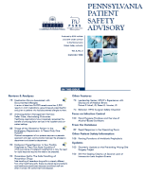




Where do the reports go?
Incoming
Reports
Triage
Patient Safety Review Meeting
Analytics
Program Outputs
Facilities’ own analyses
Facility Contacts re: individual events
Patient Safety Liaisons
Online & live education
Advisories/ Recommendations
Web sites
Collaborations
Notes:
This model shows the primary activities of the PA-PSRS program. As healthcare facilities submit reports, the system prioritizes the reports automatically and forwards them to clinical analysts who specialize in that area. For example, pharmacists will review reports of medication errors, biomedical engineers will review equipment-related reports, and nurse/risk managers will review reports of falls, skin integrity, and complications of procedures. The analysts select the most significant cases, or meaningful patterns in the reports, to discuss in a weekly patient safety review meeting, similar to a morbidity and mortality conference. Analytics are driven by trends identified through this review process.
The outputs of the program include public advisories and recommendations for system improvement, and analysts will sometimes contact individual facilities in response to single reports or patterns in their reporting. The Authority also publishes an annual report that summarizes patterns and trends in reporting statewide.
The Authority also provides patient safety training opportunities to Pennsylvania healthcare facilities and engages in a number of outreach activities to promote the results of the PA-PSRS program’s research and to promote a culture of safety and encourage full and open disclosure of serious events to patients and their families.

Slide 29
By 2007 - A Successful Beginning
PA-PSRS Designed, Developed, and Implemented
Over one half million reports received and reviewed
Over 110 articles promoting awareness and offering guidance
Root cause analysis and other education
Special projects
Received Eisenberg Award from The Joint Commission
Positive Relationship with patient safety community

Slide 30
Where We Were - 2007
Safe Patient Experiences
Data Collection
Analysis
Guidance
PA-PSRS
Collect Reports
Patient Safety Advisories
RCA, FMEA and new user training
Specialized data analysis

Slide 31
Strategic Plan 2007 - Initiatives
Educate Executive Management and Trustees
Infection Awareness and Reduction
PassKey – Patient Safety Knowledge Exchange
Improve Reporting Consistency and Recommendations
Increase Effectiveness through Extended Presence (PSL)
Data Collaboration
Collaboration with GOHCR/Other State Agencies
Patient Safety Education and Training
Nursing Home Data Analysis
PA-PSRS System Enhancements
Maintain Success of Patient Safety Advisories

Slide 32
New Areas of Focus – After 2007
Safe Patient Experiences
Data Collection
Analysis
Guidance
PA-PSRS
Education
Collaboration

Slide 33
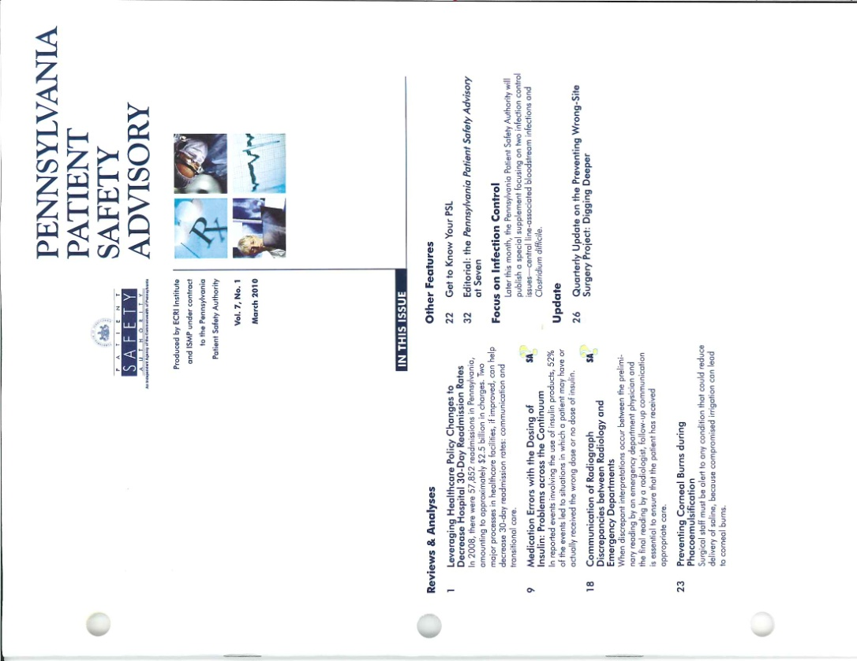
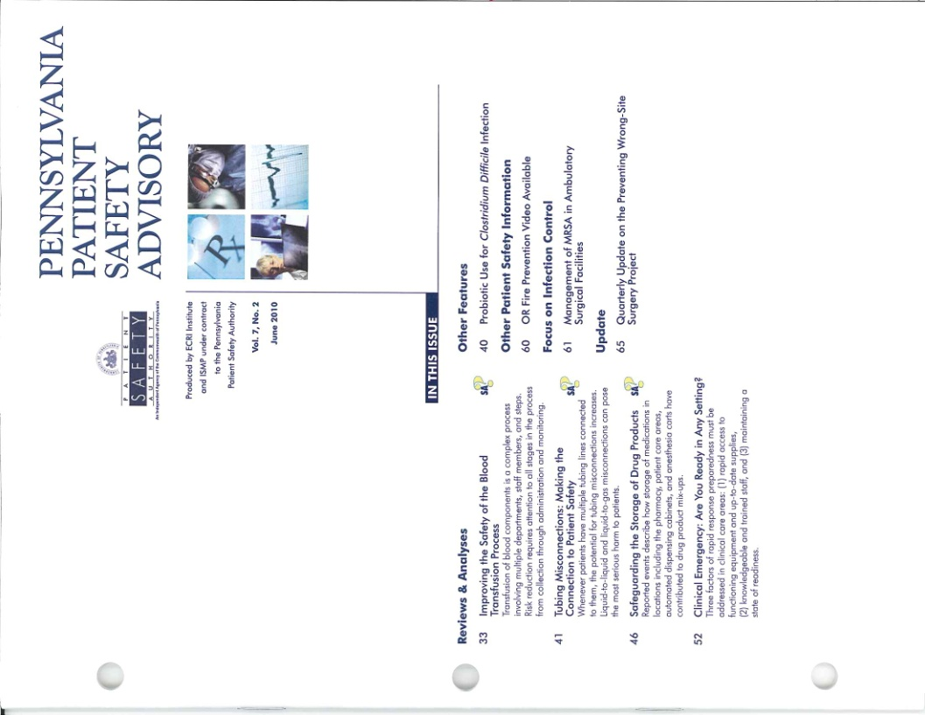
Build on Success of Patient Safety
Advisory through Enhancement
300 articles by 2013

Slide 34

www.patientsafetyauthority.org
Notes:
34

Slide 35
Patient Safety Education and Training
Regional Education Programs
Developed standing educational programs:
  Patient Safety Officer (PSO) boot camp
  Beyond the Basics
  MRSA reduction in ASFs
Patient Safety – You Design
  Root Cause Analysis
  Data Matters
  Just Culture
  Teamwork

Slide 36
Patient Safety Education and Training
Hospital/System-Specific Programs
Why reporting matters
Human Factors
Wrong Site Surgery
System-based causes of medication errors
Role of human factors in medication errors
Medication error detection and reporting
High-alert medications and high-risk processes
Educating patients about medication error prevention
Patient-controlled analgesia
Bedside bar-coding technology
Intimidation in the workplace
Building a culture of safety
Preventing errors with look- alike and sound-alike drug names
Preventing medication errors in critical access hospitals
Preventing errors with high- risk patient populations (oncology or pediatrics)

Slide 37
Patient Safety Education Attendance

Slide 38
Patient Safety Liaison Program (PSLs)
PSL promotes patient safety activities within a designated region:
    Increase direct interaction with reporting facilities
    Develop, schedule, and conduct training
    Facilitate PSO sharing and communication
    Organize and manage facility work groups
    Review reporting trends
    Advance the use of the patient safety knowledge exchange
    Serve as two-way information conduit

Slide 39

PSL Regions

Slide 40
PSA’s Collaborative Projects
Ambulatory Surgical Facility Preoperative Screening and Assessment Collaboration - the Authority used a statewide needs assessment of ASFs completed in 2011 to identify potential contributing factors to same-day cancellations of procedures and transfers to acute care. This is a collaboration with eleven participating ASFs.
Surgical Site Infection Preventive Collaborative - Authority and the Pennsylvania National Surgical Quality Improvement Program (PA- NSQIP) have been collaborating on a program to reduce surgical site infections among the PA-NSQIP member hospitals
Pennsylvania Hospital Engagement Network - recently awarded a three-year contract to work with hospitals to reduce healthcare- acquired conditions, and an initiative to prevent patient falls and reduce harm.

Slide 41
PSA’s Collaborative Projects
Central Line Associated Blood Stream Infections - In collaboration with HAP, the PSLs and infection control analysts are involved with the Comprehensive Unit-based Safety Program (CUSP) and Central line associated blood stream infections (CLABSIs) initiative in Pennsylvania. This has been a three year patient safety in-service training initiative supported by The Agency for Healthcare Research & Quality (AHRQ) to reduce central line associated blood stream infection in intensive care units.
Patient Safety Information for All HEN Hospitals Project -
As part of the Pennsylvania HEC program, all participating organizations will be expected to voluntarily participate in core set of competencies that recognize a culture of safety as the primary mechanism to improve outcomes and reduce harm.

Slide 42
PSA’s Collaborative Projects
Wrong Site Surgery Collaborative
Color Coded Wristbands Collaborative: Authority’s guidance on the use of color-coded patient wristbands to communicate important clinical information
Phlebotomy Error Reduction Collaborative: Authority sponsored collaborative in which participating hospitals worked to reduce errors in blood specimen labeling.

Slide 43
Hospital Engagement Network Structure
CMS
CMS Technical Contracting Officer
CMS Contracting Officer Representative
HAP
Culture & Education
Falls
VTE
CAUTI
Obstetrics
SSI
CLABSI
VAP
Pressure Ulcers
Readmissions
WSS
Opioids
Health Care Improvement Foundation
Quality Improvement Organization – Quality Insights of PA
Patient Safety Authority
HAP

Slide 44

PassKey – Pennsylvania Patient Safety Knowledge Exchange

Slide 45
Patient and Consumer Focus
Consumer “Tips”
Consumer brochures
Legislative senior health expos
Consumer Posters
Tips distribution to consumer groups
“I Am Patient Safety” campaign

Slide 46
PSA’s Objectives for Next Five Years
How can we best measure the Authority’s effectiveness in improving patient safety?
How can we bring consistency to reporting among the Authority, the Pennsylvania Department of Health and healthcare facilities?
How do we mutually engage patients and providers in patient safety?
How do we strategically align ourselves with healthcare providers and trends critical to patient safety
How do we learn to effectively influence facilities and providers to implement our recommendations?

Slide 47
Current (2013) Strategic Projects
Project 1: Work with DOH to Clarify Reporting Standards and Develop Recommendations Protocols
Project 2: Standardize Specific Patient Safety Events in Selected Clinical Areas and Monitor Low-Volume Reporters
Project 3: Measure Progress & Quantify Benefits
Project 4: Validate and Analyze NH HAI Data and Develop and Implement Improvement Strategies

Slide 48
Current (2013) Strategic Projects
Project 5: National Patient Safety Priorities, Common Formats & Health IT
Project 6: Increase Integration of Patient Voice into Authority Activities
Project 7: Develop Strategic Partnerships
Project 8: Execute HEN Collaboratives
Project 9: PA-PSRS Data Warehouse to Improve Data Accessibility

Slide 49
Current Progress on Standardization
Project 1:
Work with DOH to Clarify Reporting Standards and Develop Recommendations Protocols

Slide 50


PATIENT SAFETY AUTHORITY AND DEPARTMENT OF HEALTH
  Draft Guidance for Acute Healthcare Facility Determinations of Reporting Requirements under the Medical Care Availability and Reduction of Error
  Published January 3, 2014

Slide 51
“The concepts of human error and preventability do not appear in the Serious Event definition. It is not necessary for an error to be involved, nor for the harm to be preventable, for a death or unanticipated injury to constitute a Serious Event.”
“The unanticipated nature of the injury is from the perspective of a reasonably prudent patient. While every provider anticipates some rate of complications from the procedures they perform, infrequent complications are rarely anticipated by the patient unless the patient is somehow at increased risk. While we do not specify an exact threshold for the frequency of complications that makes a particular complication transition from unanticipated to anticipated, complications that occur rarely would be unanticipated by most patients.”

Slide 52
Is Pennsylvania’s
Healthcare Safer?
Project 3:
Measure Progress & Quantify Benefits

Slide 53
Signs of Improvement
the Authority began collecting data in 2004, a greater proportion of cases have been wrong-side regional blocks, suggesting a reduction in severity, if not frequency.
Catheter-related urinary tract infection rates in all unit types in Pennsylvania hospitals were lower than in comparable units nationally, ranging from 19% to 84%.

Slide 54
Signs of Improvement
A report on HAIs from the U.S. Centers for Disease Control and Prevention found that Pennsylvania’s rate of central line associated bloodstream infections was nearly one-third lower than the national average
Authority’s guidance on the use of color-coded patient wristbands to communicate important clinical information has developed into a de facto standard endorsed by the American Hospital Association and adopted in approximately half of U.S. states

Slide 55
Signs of Improvement
Authority-sponsored collaborative in which participating hospitals have substantially reduced errors in blood specimen labeling
Since 2002, payouts from the state’s excess liability fund have dropped by 58%, and the number of claims has been cut by more than half.

Slide 56
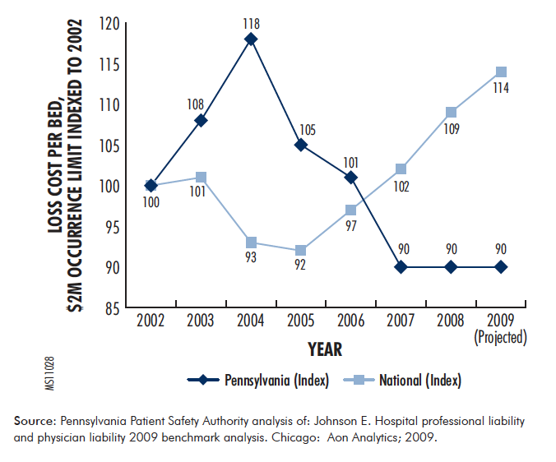

Slide 57
Status of Other Projects
Work currently being done on all other projects with time-lines and periodic updates to PSA Board.

Slide 58
Summary
Mcare Act of 2002 prompted by Institute of Medicine’s Report of 1999, “ To Err is Human,” and concern about medical availability in PA
The Patient Safety Authority and the PA Patient Safety Reporting System established
Health Care Associated Infections prompted Act 52 in 2008 to reduce HAIs in PA
The PSA remains active and productive and early results suggests improved patient safety in Pennsylvania.

