Slide 1
2013 PADC Annual Meeting
Wednesday, June 26th, 2013
10:00 a.m.-11:00 a.m.
Torresdale Frankford Country Club
Presented by: Clifford A. Rieders, Esquire
Rieders, Travis, Humphrey, Harris, Waters
Waffenschmidt & Dohrmann
161 West 3rd Street
Williamsport, PA 17701
570-323-8711
www.riederstravis.com

Slide 2
Restatement (2d) of Torts § 402A
(1) One who sells any product in a defective condition unreasonably dangerous to the user or consumer or to his property is subject to liability for physical harm thereby caused to the ultimate user or consumer, or to his property, if
(a) the seller is engaged in the business of selling such a product, and
(b) it is expected to and does reach the user or consumer without substantial change in the condition in which it is sold.
(2) The rule stated in Subsection (1) applies although
(a) the seller has exercised all possible care in the preparation and sale of his product, and
(b) the user or consumer has not bought the product from or entered into any contractual relation with the seller.

Slide 3
Restatement (3d) of Torts: Products Liability § 1 & 2 (1998)
§ 1. Liability Of Commercial Seller Or Distributor For Harm Caused By Defective Products
One engaged in the business of selling or otherwise distributing products who sells or distributes a defective product is subject to liability for harm to persons or property caused by the defect.

Slide 4
Restatement (3d) of Torts: Products Liability § 1 & 2 (1998)
§ 2. Categories Of Product Defect
A product is defective when, at the time of sale or distribution, it contains a manufacturing defect, is defective in design, or is defective because of inadequate instructions or warnings. A product:
(a) contains a manufacturing defect when the product departs from its intended design even though all possible care was exercised in the preparation and marketing of the product;
(b) is defective in design when the foreseeable risks of harm posed by the product could have been reduced or avoided by the adoption of a reasonable alternative design by the seller or other distributor, or a predecessor in the commercial chain of distribution, and the omission of the alternative design renders the product not reasonably safe;
(c) is defective because of inadequate instructions or warnings when the foreseeable risks of harm posed by the product could have been reduced or avoided by the provision of reasonable instructions or warnings by the seller or other distributor, or a predecessor in the commercial chain of distribution, and the omission of the instructions or warnings renders the product not reasonably safe.

Slide 5
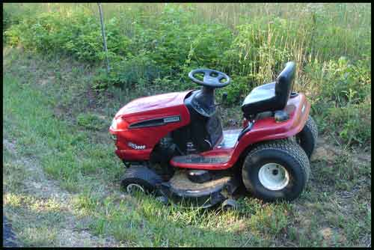
Berrier v. Simplicity Mfg., Inc. 563 F.3d 38,40 (3d Cir.2009)
A child was injured when her grandfather reversed a riding lawnmower that lacked “backover” protection.
The court said that the Restatement Third §§ 1 and 2 would apply and it was foreseeable that a child would be injured by the defective lawnmower.
We predict that if the Pennsylvania Supreme Court were confronted with this issue, it would adopt the Restatement (Third) of Torts, §§ 1 and 2, and thereby afford bystanders a cause of action in strict liability under the circumstances here. (Footnote omitted)

Slide 6
Bugosh v. I.U. North America, Inc. Per Curiam Order decided June 16, 2009. 971 A.2d 1128 (2009)
Appeal dismissed as having been improvidently granted
Bugosh vs. I.U. North America, Inc., per curiam, Order decided June 16, 2009. Dismisses appeal as having been improvidently granted with a lengthy treatise written by Mr. Justice Saylor and joined in by Mr. Justice Castille as a template for the future.
Heavy reliance upon Phillips vs. Cricket Lighters, 841 A.2d 1000 (2003) (plurality) involving cigarette lighter used by child to start a fire. Child not intended user and hence 402A did not apply. Under Restatement Third, child bystander would be covered.

Slide 7
Bugosh v. I.U. North America, Inc. Per Curiam Order decided June 16, 2009. 971 A.2d 1228 (2009)
Reporters Twerski and Henderson say in their commentary that Pennsylvania law is consistent with the Restatement Third because the judge is the gatekeeper on the risk-utility analysis and the jury decides defective product.
The Restatement Third was intended to reestablish a cause of action in states which had statutorily eliminated strict liability and developed much more anti-consumer law than the Restatement Third. Pennsylvania law was not a target of the reporters in the Restatement Third.

Slide 8
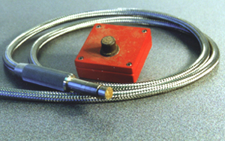
Barnish v. KWI Bldg. Co. 602 Pa. 402, 980 A.2d 535 (2009)
Products liability action, arising from an explosion and fire at a particleboard manufacturing facility, against manufacturer of spark detection system that had been installed at the particleboard facility.
“To bring a Section 402A claim, a plaintiff must demonstrate, inter alia, that the product was defective, that the defect caused the plaintiff's injury, and the defect existed at the time the product left the manufacturer's control.” Id. at 541(emphasis added).

Slide 9
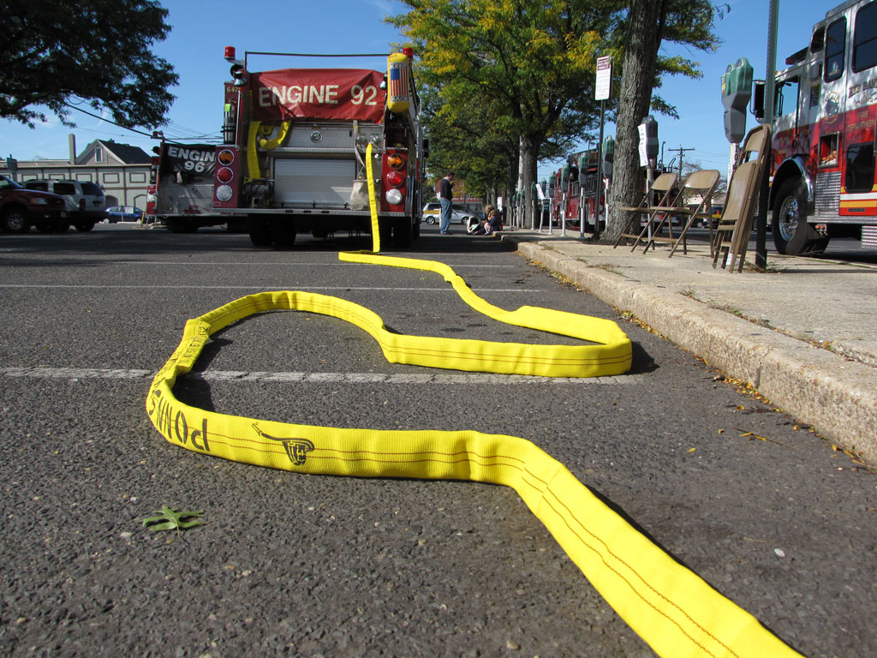
Schmidt v. Boardman Co. 11 A.3d 924 (Pa. 2011)
Accidental, in-transit deployment by fire-engine hose which caused the death of one child and severe injury to another and emotional distress on the part of family-member witnesses.
The question of course involved product-line exception to general rule of successor non-liability in strict product liability actions and whether in a strict liability proceeding a plaintiff must prove a physical injury.

Slide 10
Schmidt v. Boardman Co. 11 A.3d 924 (Pa. 2011)
The jury instruction achieved the most appropriate reconciliation of governing Superior Court precedent as reflected in decisions.
Charge was entirely faithful to the Dawejko v. Jorgensen Steel Co., 434 A.2d 106 (1981) language and various other factors indentified as criteria which are used in the product-line assessment.
The issue of whether a determination of product-line successor status is for the judge or the jury is not before us.
We only hold that under the most appropriate reconciliation of presently prevailing Superior Court precedent, the trial court did not err its main instruction to the jury concerning product-line exception

Slide 11
Schmidt v. Boardman Co. 11 A.3d 924 (Pa. 2011)
We hold that for purposes of strict liability claim a plaintiff’s recovery for emotional distress is limited to that which is proximately caused by contemporaneous physical impact. However, this view does not command a majority and is only joined in by Saylor, Castille and Eakin, with Greenspan not participating in the case.
The Supreme Court reviewed the question “whether, in strict liability proceedings, a plaintiff must prove a physical injury as a threshold to recovery” and affirmed the Superior Court by operation of law because the Supreme Court is equally divided on the issue.

Slide 12
Covell v. Easton-Bell Sports, Inc. 651 F.3d 357 (3d Cir. 2011)
The court reaffirms that the Third Circuit will use the Restatement Third.
Case involved allegedly defective helmet.
We affirm the District Court’s application of Sections 1 and 2 of the Restatement (Third) of Torts. Therefore, compliance with regulations comes into the case.

Slide 13
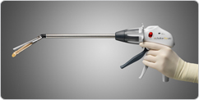
Beard v. Johnson and Johnson, Inc. 41 A.3d 823 (Pa. 2012)
After gastric bypass surgery, patient’s stomach leaked causing sepsis and death.
Her estate brought a medical device product liability claim for the linear stapler and cutting device (“endocutter”) used in her surgery when there was an absence of staples on two small line segments.
Jury awarded $5 million on design defect theory and rejected malfunction theory.

Slide 14
Beard v. Johnson and Johnson, Inc. 41 A.3d 823 (Pa. 2012)
Expert essentially offered “design defect” in rebuttal to alternative cause for the injury provided by the defense to undercut the “malfunction theory.”
Design defect was the failure to have a gauge to inform the surgeon of the required size for the staples and/or the lack of a guard to prevent stapling areas that are too thick for the staple.

Slide 15
Beard v. Johnson and Johnson, Inc. 41 A.3d 823 (Pa. 2012)
For the threshold utility-risk analysis of whether a product is outweighed by its use, the Court held that trial courts are not restricted to considering a single use of a multi-use product in design defect.
Here, there was no testimony that the endocutter could be used with a gauge or lock for laparoscopic surgery and court did not need to evaluate for open surgery use.
The Restatement Third would assign this balancing to the jury.

Slide 16
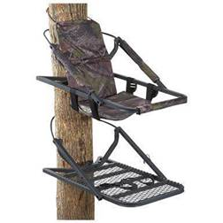
Reott v. Asia Trend, Inc. 55 A.3d 1088 (Pa. 2012)
Buyer of a tree stand was injured when the tree stand collapsed which was indisputably a substantial factor in causing buyer’s injuries.
The Superior Court noted that while there was a jury question as to whether his “setting the stand” maneuver of bobbing up and down on his toes entailed a high degree of risk of injury or death, there was no evidence that this maneuver could have caused the collapse in the absence of a defect.

Slide 17
Reott v. Asia Trend, Inc. 55 A.3d 1088 (Pa. 2012)
Pa. Supreme Court affirmed and held that allegedly reckless use of tree stand was an affirmative defense to strict liability that must be pleaded and proven that conduct was so reckless as to constitute sole or super case of injuries, abrogating Berkebile v. Brantly Helicopter Corp., 337 A.2d. 893
Reversed on issue of causation and remanded for new trial limited to issue of damages.

Slide 18
Eastern District Of PA

Slide 19
Eastern District of PA
Hoffman v. Paper Converting Machine, Co. 694 F. Supp. 2d 35 (E.D. Pa 2010) (Tucker) noting Bugosh dismissal without deciding the issue, opted to follow Berrier as “binding precedent,” citing with approval Richetta v. Stanley Fastening Systems, 661 F. Supp. 2d 500 (E.D. Pa. 2009) and Martinez v. Skirmish USA, 2009 WL 1437624(E.D. Pa. 2009).
Zhao v. Skinner Engine Co., 2012 WL 5451817 (E.D. Pa. 2012) (Yohn) also followed Berrier.

Slide 20
Eastern District of PA
Thompson v. Med-Mizer, Inc., 2011 WL 1085621 (E.D. Pa. 2011)(“This court is not required to follow the 3rd Circuit’s prediction where ‘the state’s highest court issues a decision contradicting that prediction or state intermediate appellate court’s decision subsequently indicate that prediction has not come to pass’ ”) citing Seitzer v. Oxmaster, Inc. 2010 WL 5257226, at 3-4 (E.D. Pa. 2010) and Durkot v. Tesco Equip., 654 F. Supp. 2d 295, 298-99 (E.D. Pa. 2009).
Carpenter v. Shu Bee’s Inc., 2012 WL 2740896 (E.D. Pa. 2012)(referred to Restatement 2d analysis)(Mag. Judge Perkin)

Slide 21
Western District Of PA

Slide 22
Western District of PA
Gross v. Stryker, 858 F. Supp. 2d 466 (W.D. Pa. 2012)(Fischer)(applying Restatement SECOND, contrary to Berrier)
Konold v. Superior International Industries, Inc., 2012 WL 5381700 (W.D. Pa. 2012 (Schwab)(ditto)

Slide 23
Western District of PA
Schif v. Hurwitz, 2012 WL 1828035 (W.D. Pa. 2012)(also Schwab)
Gilmore v. Ford Motor Co, 2013 WL 869382 (W.D. Pa. Mar. 7, 2013)(“The Order by the United States Court of Appeals for the Third Circuit in Sikkelee was non-precedential, and this Court is not bound by non-precedential decisions …Thus, this Court is free to stand by its position that Beard v. Johnson & Johnson, Inc., 41 A.3d 823, 836 (Pa.2012) is contrary to Covell v. Bell Sports, Inc. ., 651 F.3d 357, 360 (3d Cir.2011)”) (Schwab).

Slide 24
Western District of PA
Sansom et al. v. Crown Equipment Corp., 2012 WL 3027989 (W.D. Pa. 2012) (applying Restatement THIRD, under Third Circuit prediction)(Hornak)
Lynn v. Yamaha Golf-Car Co. 2012 WL 3544774 (W.D. Pa. 2012)(also Hornak)
Zollars et al., v. Troy-Built LLC, 2012 WL 4922689 (W.D. Pa. 2012)(applying Restatement THIRD)(Ambrose)

Slide 25
Western District of PA
Spowal v. ITW Food Equipment Group, No. C. A. 10-187, ECF No. 52 (W.D. Pa. 2012)(Cohill)(ditto)
Punch v. Dollar Tree Stores, Inc., 2013 WL 1421514 (W.D. Pa. Jan. 24, 2013) (this Court is aligned with the majority of the District Court decisions in our Circuit that have concluded that Beard is not a contrary decision and that the Third Circuit Court's predictive holdings in Berrier and Covell are binding.)(Magistrate Judge Baxter) report and recommendation adopted, 2013 WL 1788063 (W.D. Pa. Apr. 8, 2013)(McLaughlin)

Slide 26
Middle District Of PA

Slide 27
Middle District of PA
U.S. District Judge Caputo has repeatedly ruled based on Covell that the Restatement THIRD should be applied. See Vaskas v. Kenworth, 2013 WL 101612 (M.D. Pa. 2013); Giehl v. Terex Utilities, 2012 WL 1183719 (M.D. Pa. 2012).
Shuman v. Remtron, Inc., 2012 WL 315445 (M.D. Pa. Feb. 1, 2012) (Unless or until the Pennsylvania Supreme Court either rejects the Restatement (Third) or indicates that it will continue to adhere to Section 402A of the Restatement (Second), we are bound by Covell.) (Magistrate Judge Smyser)

Slide 28
Middle District of PA
Sikkelee v. Precision Automotive, 876 F. Supp. 2d 479 (M.D. Pa. 2012)(Jones) (noting that federal district courts are not required to follow predictions by the 3d Cir. If that prediction does not appear to have been realized in state court precedent)
BUT SEE Sikkelee v. Precision Airmotive Corp., 2012 WL 5077571 (3d Cir. Oct. 17, 2012)(“The Pennsylvania Supreme Court has not issued a definitive opinion on whether the Restatement (Third) of Torts or the Restatements (Second) of Torts and applies to strict liability and product defect cases. Accordingly, we will follow the precedent set out in Covell and Berrier.”) (denying petition for rehearing en banc and panel rehearing).

Slide 29
Middle District of PA
Sikkelee v. Precision Airmotive Corp., No. 4:07-cv-00886, Memorandum and Order filed June 3, 2013)
Judge Brann, to whom the case was reassigned, revisited the earlier denial of summary judgment by Judge Jones, in light of the “[Third] Circuit’s direction that the Restatement (Third) is applicable to this action.” Judge Brann concluded that while Covell reaffirmed the prediction that Pennsylvania’s Supreme Court will adopt Sections 1 & 2 of the Restatement 3rd, that did not necessarily mean that it will adopt Section 20, on which the defendant relied: “Lycoming has provided no support for the notion that Pennsylvania will adopt §20, and this Court has discovered none,” noting that [Lycoming’s] “argument… assumes that Restatements are adopted wholesale when they are not.” Judge Brann concluded that there was no change in the relevant law and Judge Jones’ prior Opinion denying summary judgment did not constitute a clear error of law. The Motion for Reconsideration was denied.

Slide 30
Middle District of PA
“Lycoming has provided no support for the notion that Pennsylvania will adopt §20, and this Court has discovered none,” noting that [Lycoming’s] “argument… assumes that Restatements are adopted wholesale when they are not.” Judge Brann concluded that there was no change in the relevant law and Judge Jones’ prior Opinion denying summary judgment did not constitute a clear error of law. The Motion for Reconsideration was denied.

